Slide 1
Time Series Database With B+ Tree Index
CS 4525 Advanced Database Management
Kyle Allan

Slide 2
Description
Built a Time-Series Database in SQL that stores and retrieves data
Implemented a B+ tree for storing and retrieving time-series data
Built an API for the B+ Tree
Compared the query performance of the B+ tree vs SQL database

Slide 3
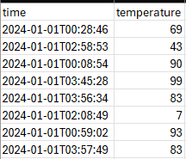
My Data
Generated a csv using python that holds 150 000 entries of time and temperature data and another holding 15 000 entries
This is the data that will be used to test insertion on SQL and B+ Tree

Slide 4
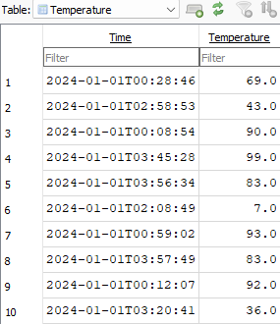

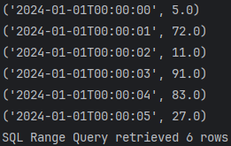
Minimum – SQL Database
Implemented SQLite database using python that stores my time-series data
Test Cases:
Insertion stream
Uses generated csv file to insert into database
Search with exact time
Range query
Snapshot in DB Browser for SQLite

Slide 5
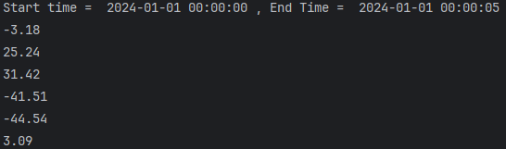
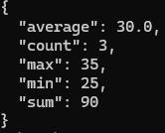
Intermediate - B+ Tree
Implemented a B+ tree found on GitHub
Customized it to include a range query function and basic aggregations such as sum, average, min, max and count

Slide 6
Advanced & Intermediate - Performance
Query and Size | SQL | B+ Tree
Insert (15 000) | 0.04 seconds | 0.10 seconds
Range (15 000) | 0.01 seconds | 0.003 seconds
Exact (15 000) | 0.000103 seconds | 0.000015 seconds
Insert (150 000) | 0.88 seconds | 1.55 seconds
Range (150 000) | 0.08 seconds | 0.04 seconds
Exact (150 000) | 0.0003037 seconds | 0.000022 seconds

Slide 7
REST API – B+ Tree
Implemented in Python using Flask
Use a batch file with cURL to test insertion, search exact time, retrieve by date range, and aggregate queries

Slide 8
Conclusion
Implemented a time-series SQL database
Worked with DB Browser for SQLite for the first time to test my SQL database
Implemented a B+ tree in python and created range and aggregate functions
Built an API with Flask for the B+ tree

Slide 9
Resources
https://github.com/WckdAwe/Python-BPlusTree
ChatGPT
GitHub: https://github.com/Kyle-Allan/CS-4525-Project

